Slide 1
How are Meanders Formed?
Identify and use new key words appropriately
Understand and explain how a meander is formed
Predict what might happen in the future if meanders keep growing

Slide 2

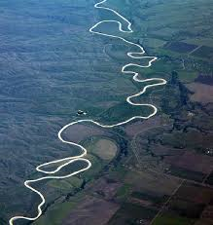
What is a meander?
Identify and use new key words appropriately
Understand how a meander is formed

Slide 3
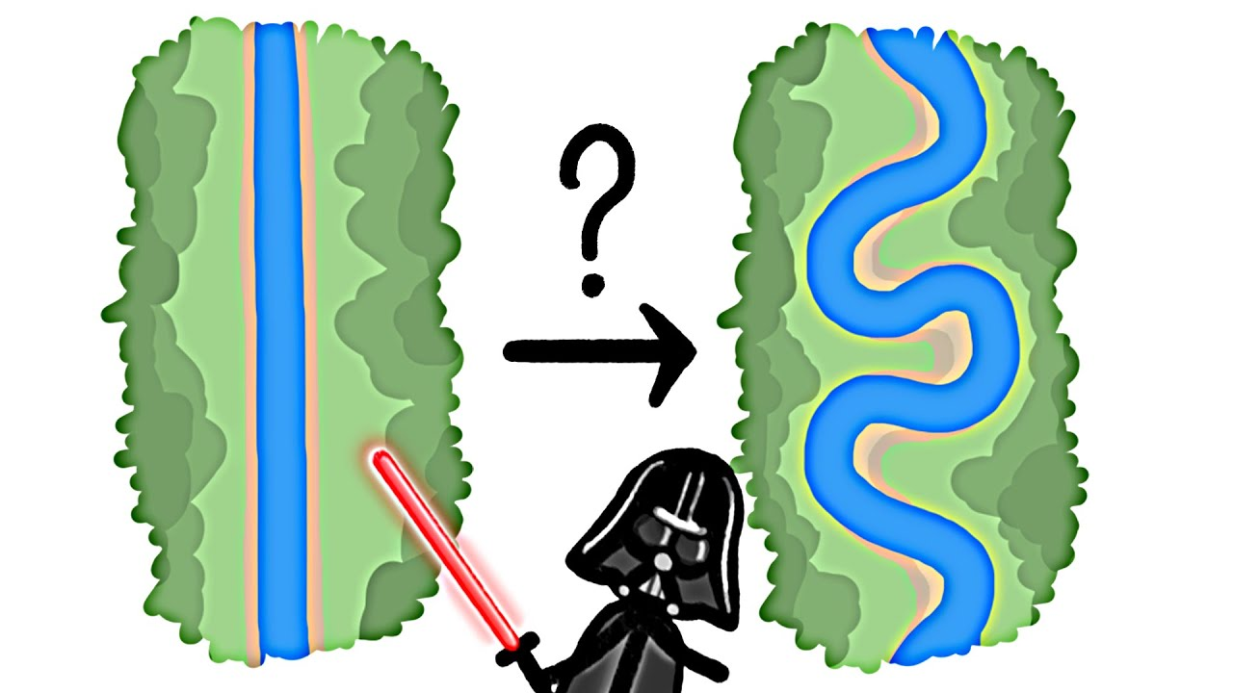
So how does a river go from being straight, to being bendy?!

Slide 4
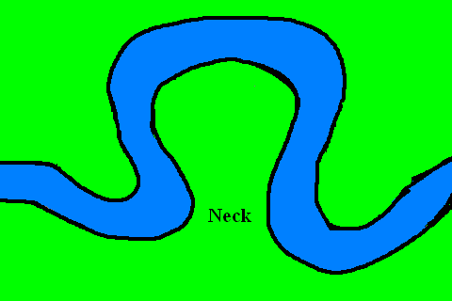
The water flowing around the outside of a bend goes really quickly! This means it has lots of energy!
The water flowing around the inside of a bend goes much more slowly. This means it doesn’t have much energy at all!

Slide 5
So what does the fast and slow water do?
The fast water going around the outside of the bend is very powerful and, when it bashes against the side of the river, it wears the sides away. This means little bits of the rock at the side of the river break away and fall into the river. It creates a cliff at the side of the river.
We call the little bits of rock that break away sediment.
When the sides wear away, it is called erosion.
The slow water flowing around the inside of the bend doesn’t have a lot of energy at all! This means it can’t carry much, so it put’s all the little bits of material (sediment) it has eroded from the sides of the river down on the inside of the bend. This creates a little beach!
When the slow water puts down the sediment it is carrying, it is called deposition.

Slide 6
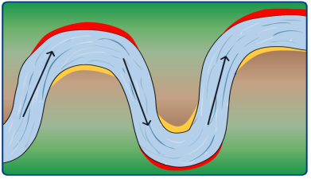
MEANDERS
Task: Sort out and annotate the 4 stages of a river meander.
Task 1: Circle what process (erosion or deposition) is happening at the outside and inside of a river bend. Task 2: What river features are shown at locations 1 and 2.
erosion or deposition ?
outside of
river bend
1.
outside of
river bend
1.
2.
2.
inside of
river bend
inside of
river bend
erosion or
deposition ?
erosion or
deposition ?
erosion or deposition ?
inside of
river bend
Key
1: Beach or river cliff ?
2: Beach or river cliff ?
2.
outside of
river bend
1.
BIRD’S-EYE VIEW
OF A RIVER
erosion or deposition ?

Slide 7
MEANDERS
Task: Sort out and annotate the 4 stages of a river meander.
Check your answers:
erosion or deposition ?
outside of
river bend
1.
outside of
river bend
1.
2.
2.
inside of
river bend
inside of
river bend
erosion or
deposition ?
erosion or
deposition ?
erosion or deposition ?
inside of
river bend
Key
1: RIVER CLIFF
2: BEACH
2.
outside of
river bend
1.
BIRD’S-EYE VIEW
OF A RIVER
erosion or deposition ?

Slide 8
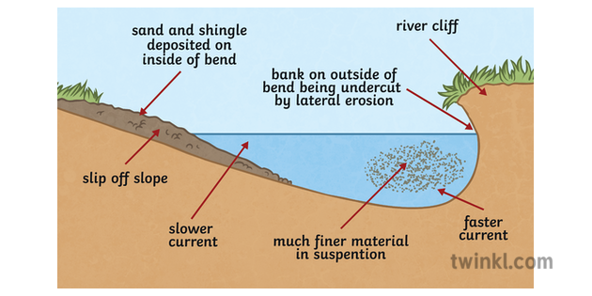
Let’s have a look at what the meander looks like on the inside of the river…
A river cliff is created
A beach is being created where the sediment is gathering.
River bank being worn away (ERODED)
The water has dropped lots of sediment on the inside of the rivers bend.
(DEOPOSITION)
Much slower, more shallow water which has less energy
Deep, fast water with lots of energy
Little bits of rock from the side of the river that have been eroded (SEDIMENT)

Slide 9
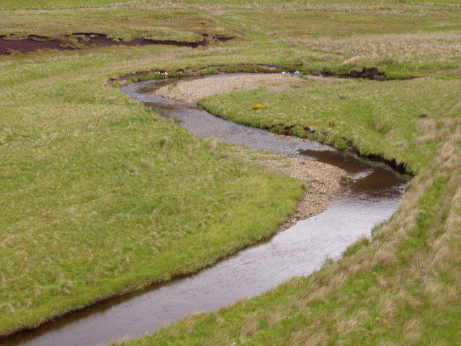
Here you can see the outside is being worn away (eroded)!
Here you can see the little bits of rock (sediment) are being put down by the river creating little beaches. Don’t forget this is called deposition.
You can see this happening in this picture. The outside of the river is being eroded and being made bigger. Deposition is happening on the inside creating a little beach!

Slide 10
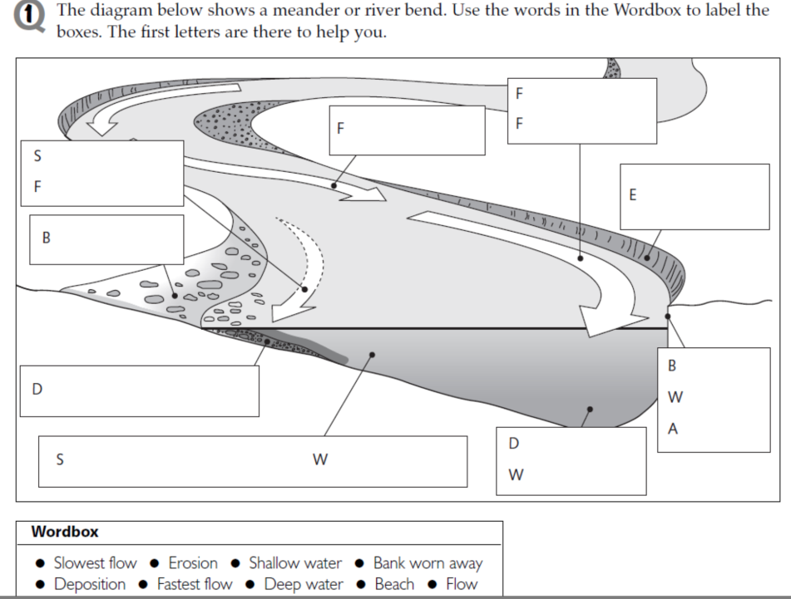
Task 3: Use the word box at the bottom to label the diagram. The first letters are there to help you. You can draw your own or do it on the computer…

Slide 11
Check your answers:
MEANDERS
fastest flow
08.
flow
slowest flow
01.
09.
erosion
beach
02.
07.
bank
worn
away
deposition
03.
shallow water
deep
water
04.
06.
05.

Slide 12
Task 4: Copy and complete the sentence to help you to explain how a meander is formed. Use the word box at the bottom to help you.
A river rarely flows in a straight line, it usually has lots of big bends in it. We call those bends, meanders. A meander is formed because of the different speed and amount of water in the river. On the outside of a meander there is a large amount of water which flows quickly. This means it has a lot of energy. It uses this energy to erode (wear away) the side of the river, creating a river cliff. The bits of rock that have worn away are called sediment and are carried by the river. On the inside of the river, there is much less water and it flows more slowly. This means it has less energy and so it drops off all the bits of rock it was carrying (this is called deposition. The bits of material gather together on the inside of the bend creating a beach. .
Word bank: less, beach, straight , quickly, erode, energy, sediment, slowly, large, deposition, meanders, river cliff

Slide 13
Check your answers:
A river rarely flows in a straight line, it usually has lots of big bends in it. We call those bends, meanders. A meander is formed because of the different speed and amount of water in the river. On the outside of a meander there is a large amount of water which flows quickly. This means it has a lot of energy. It uses this energy to erode (wear away) the side of the river, creating a river cliff. The bits of rock that have worn away are called sediment and are carried by the river. On the inside of the river, there is much less water and it flows more slowly. This means it has less energy and so it drops off all the bits of rock it was carrying (this is called deposition. The bits of material gather together on the inside of the bend creating a beach.
Word bank: less, beach, straight , quickly, erode, energy, sediment, slowly, large, deposition, meanders, river cliff

Slide 14
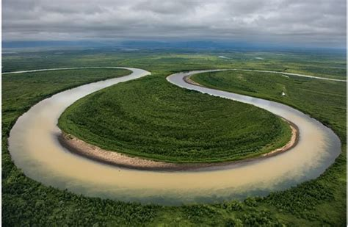
If the processes we’ve talked about keeps occurring, what do you think will happen eventually?
Watch the video and see if you can come up with any ideas…
http://www.cleo.net.uk/resources/displayframe.php?src=309/consultants_resources/_files/meander4.swf
Predict what might happen in the future if meanders keep growing

Slide 15
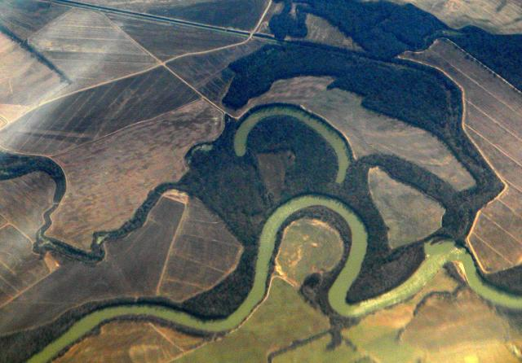
Oxbow Lake
Predict what might happen in the future if meanders keep growing

Slide 16
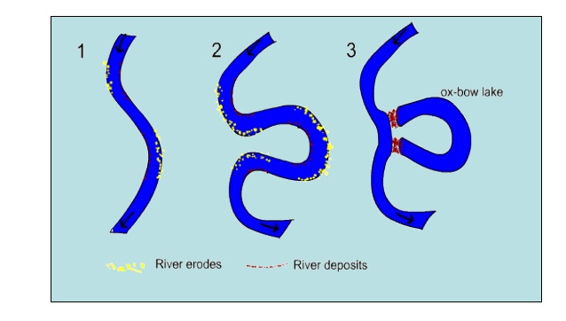
Task 5: Draw the following diagrams and add labels to explain how the oxbow lake was created…

Slide 17
The outsides of the meander are being eroded so much that they are getting closer to each other,
Eventually, the close bends will erode until they form a new course for the water to travel straight down.
The fast water is eroding the outside of the bend making it bigger.
The slow water is depositing sediment creating little beaches on the inside of the bend.
The old meander is totally cut off from the river and is now an oxbow lake.
If the river floods, it will take the shortest route and go straight over the close bends.

